Slide 1
Working with State Leadership
Feel free to use any of these slides for the context of your audience

Slide 2
Your Logo Here
High-Impact Tutoring: Equitable and Effective Student Acceleration

Slide 3
These next two slides represent national data
Please use your state and local data instead if you have it available as your own student data will make more of an impact.
Messaging:
Despite best educator and administration efforts, students are behind because of covid-disrupted schooling and students furthest behind have been impacted the most.

Slide 4
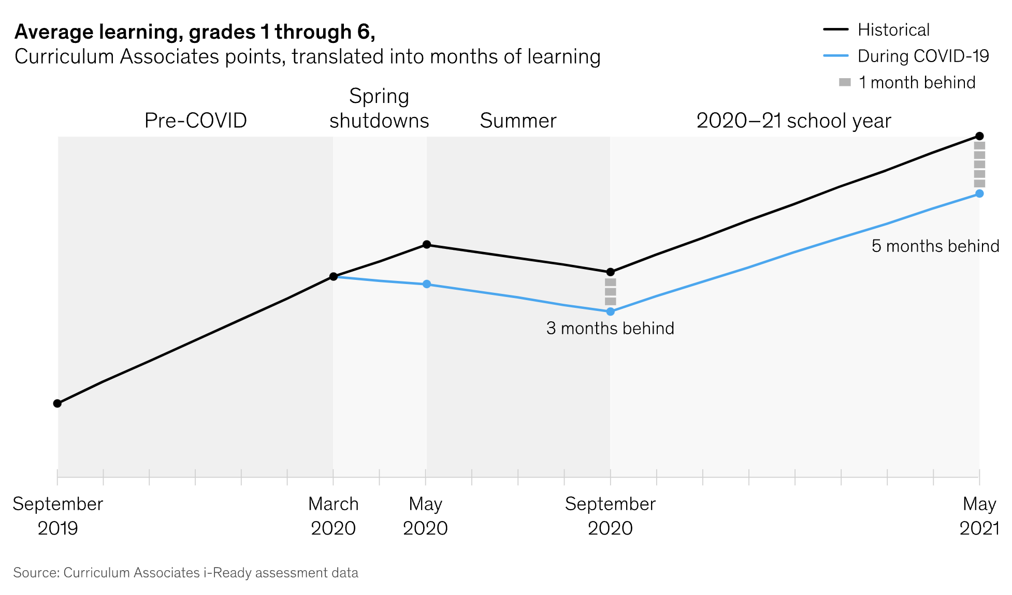
Pandemic interrupted attendance and learning
Students behind Math 5 months, ELA 4 Months, on average

Slide 5
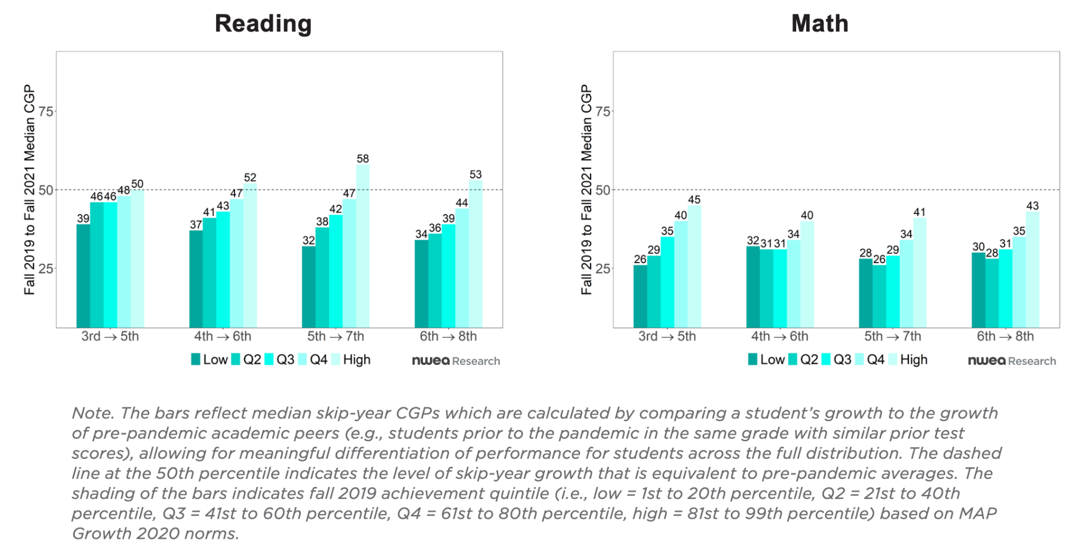
Pandemic increased inequality in outcomes
MAP Growth skip-year conditional growth percentiles by fall 2019 achievement

Slide 6
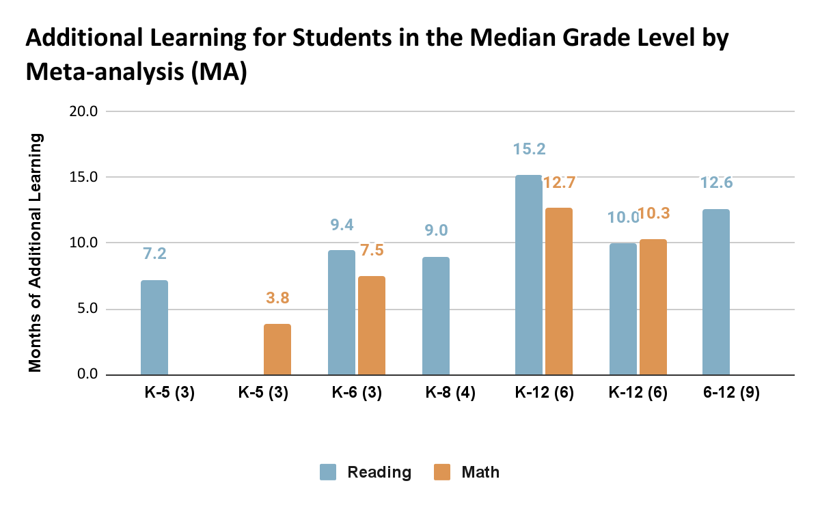
Unusually Large Body of Evidence
In the last five years, 7 meta-analyses including over 150 studies consistently find that tutoring results in up to 15 months of additional learning for students.
Note: Meta-analyses 1, 2, 4 and 7 only considered one subject area, while meta-analyses 3, 5 and 6 included both reading and math.

Slide 7
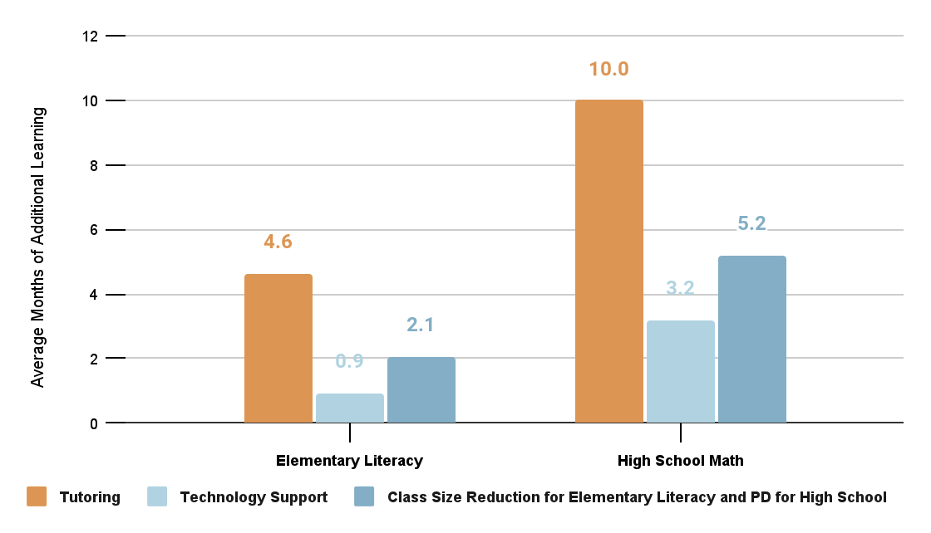
Tutoring appears more effective than other academic interventions
Please note that data are not available for the impact of professional development on early literacy learning or class size reduction for high school math learning.

Slide 8
Not all tutoring is effective
No Child Left Behind Supplementary Educational Services
Allowed low-income parents to enroll child in state-approved tutoring program if their school not making adequate yearly progress for 2 consecutive years.
Low participation; Little benefit for student learning, on average.
Instances where SES benefited student learning tended to involve: minimum dosage requirements, structured sessions, tutor coordination with schools, and more tutor experience (Heinrich et al., 2014).
Sources: Heinrich, Carolyn J., Meyer, Robert H. and Greg Whitten. 2010. “Supplemental Education Services under No Child Left Behind: Who Signs Up, and What Do They Gain?” Educational Evaluation and Policy Analysis 32 (June): 273-298; and Heinrich, Carolyn J., Patricia Burch, Annalee Good, Rudy Acosta, Huiping Cheng, Marcus Dillender, Christi Kirshbaum, Hiren Nisar and Mary S. Stewart. 2014. “Improving the Implementation and Effectiveness of Out-of-School-Time Tutoring.” Journal of Policy Analysis and Management, 33(2): 471-494.

Slide 9
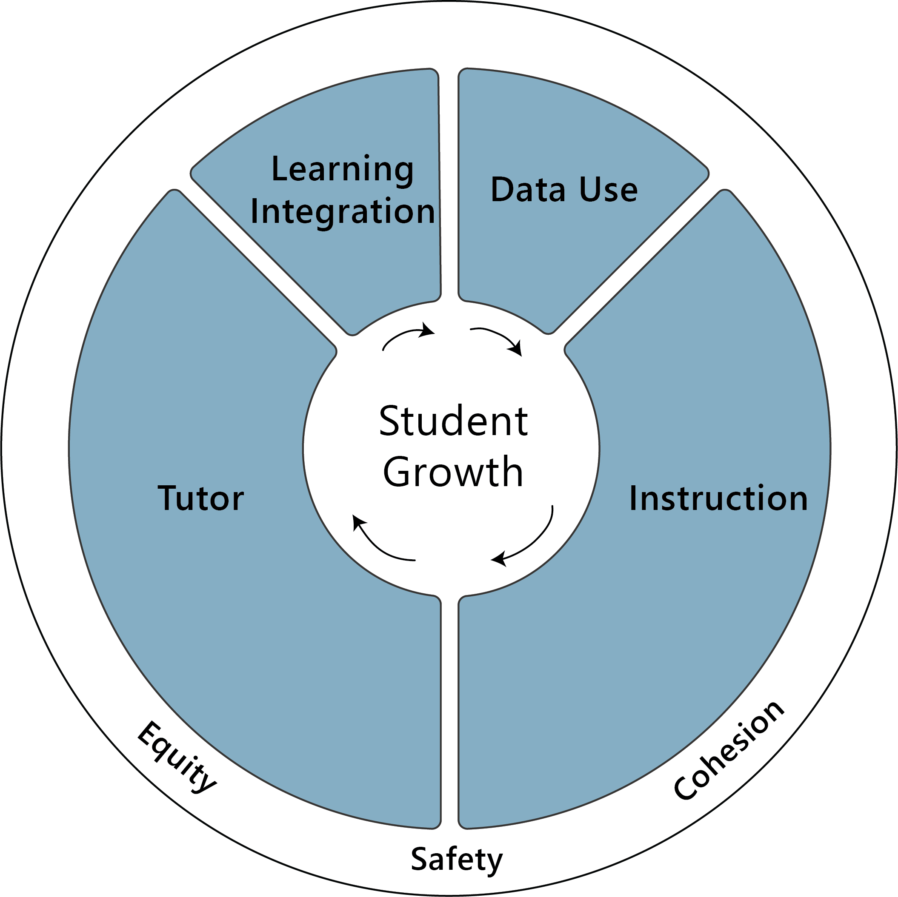
What is High-Impact Tutoring?
Learning Integration
embedded in school
Data Use
drives instruction
Tutor
consistent, well supported
Instruction
High-dosage,using high quality materials
Grounded in Equity

Slide 10
High-Impact Tutoring
Is | Is Not
With a consistent tutor | With a different tutor each time
Relationship-focused | Question-resolution focused
Data-informed instruction | Student-generated homework help
Focused on acceleration | Focused on remediation
Regularly scheduled a minimum of three times per week | As needed
Embedded in school | An extra-curricular that relies on parent take up and/or payment

Slide 11
Unique opportunity to adopt tutoring now
High student need in (name state)
Qualifies for ESSER Funding now
Include sustainable funding options here (see notes)
Research-Proven Equitable and Effective Intervention
Successful Examples in Range of Districts and States
Will alleviate educator fatigue by providing additional supports
Likely to increase (name of state’s) educator pipeline
Shown to improve school engagement and likely to support student well-being
Notes:
Select the reasons that will most resonate with your board
State examples can be found here and district examples here
Funding options here

Slide 12
Add additional slides as appropriate
Outline of proposed program (grades, content areas, student selection process, source of tutors, estimated costs, etc.)
Overview of other covid–recovery efforts and how high-impact tutoring fits within existing programs
Supportive statements from school or district leadership

Slide 13
Next Steps
Propose clear action steps (e.g., establish a task force, present a formal proposal, etc.)

Slide 14
Additional more detailed slides

Slide 15
What is High-Impact Tutoring?
Learning Integration
embedded in school
Data Use
drives instruction
Tutor
consistent, well supported
Instruction
High-dosage,using high quality materials
Grounded in Equity

Slide 16
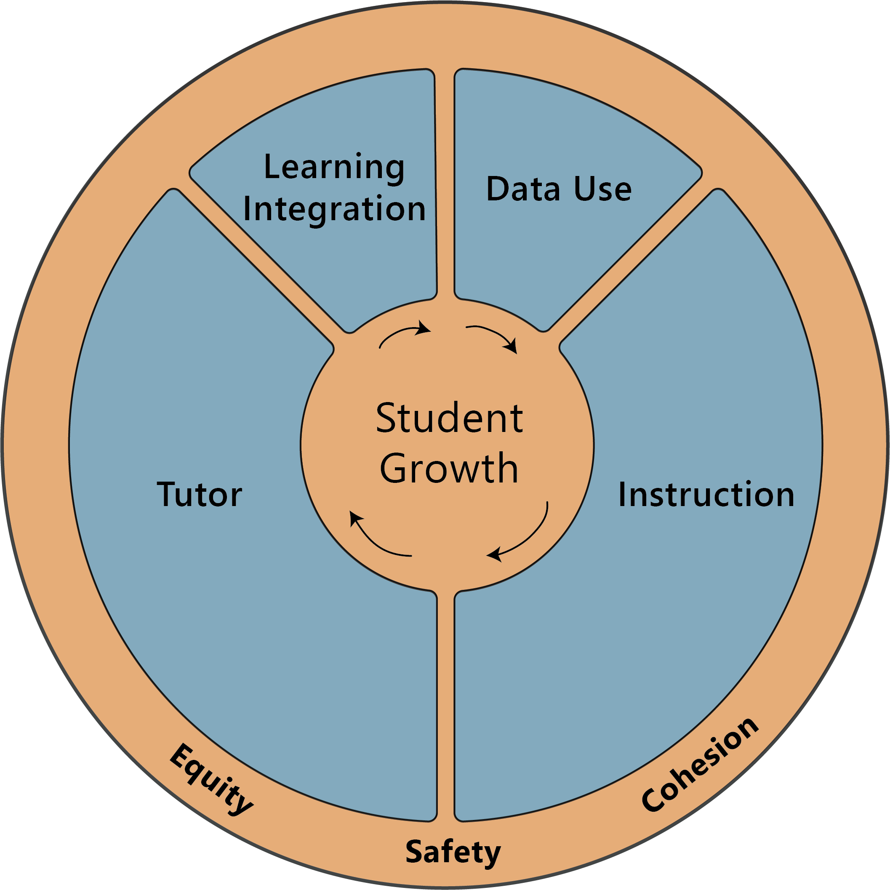
Equity, Safety, Cohesion
High-Impact tutoring programs are
grounded in Equity,
ensure Safety of students and their information and are
Cohesive – designed for program elements to work well together and led by a strong leadership team.

Slide 17
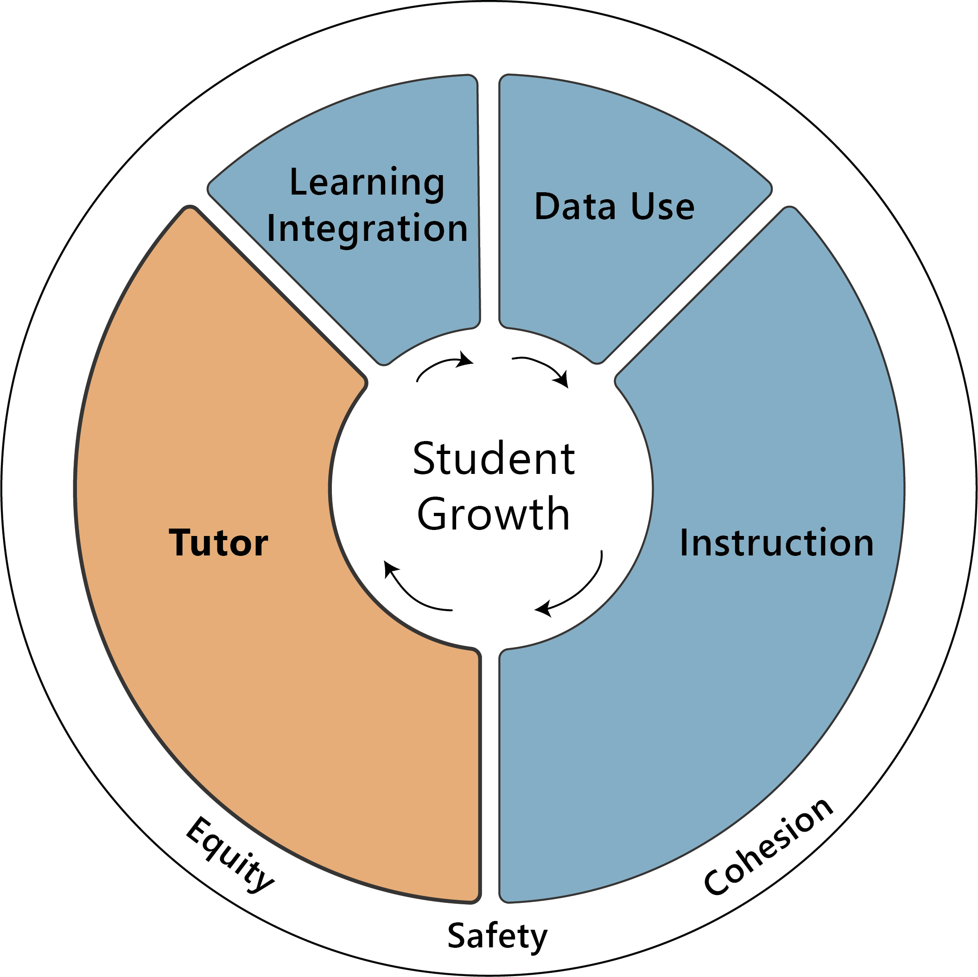
Tutor
Students work with a consistent tutor who is supported
by ongoing oversight and coaching.
Tutors
are skilled at relationship-building and knowledgeable about content,
need initial training, oversight, ongoing coaching and clear lines of accountability and
are culturally competent and reflect the lived experience of the students they serve.
Notes:
preview that y'all will talk more about who tutors are at the end of the section?

Slide 18
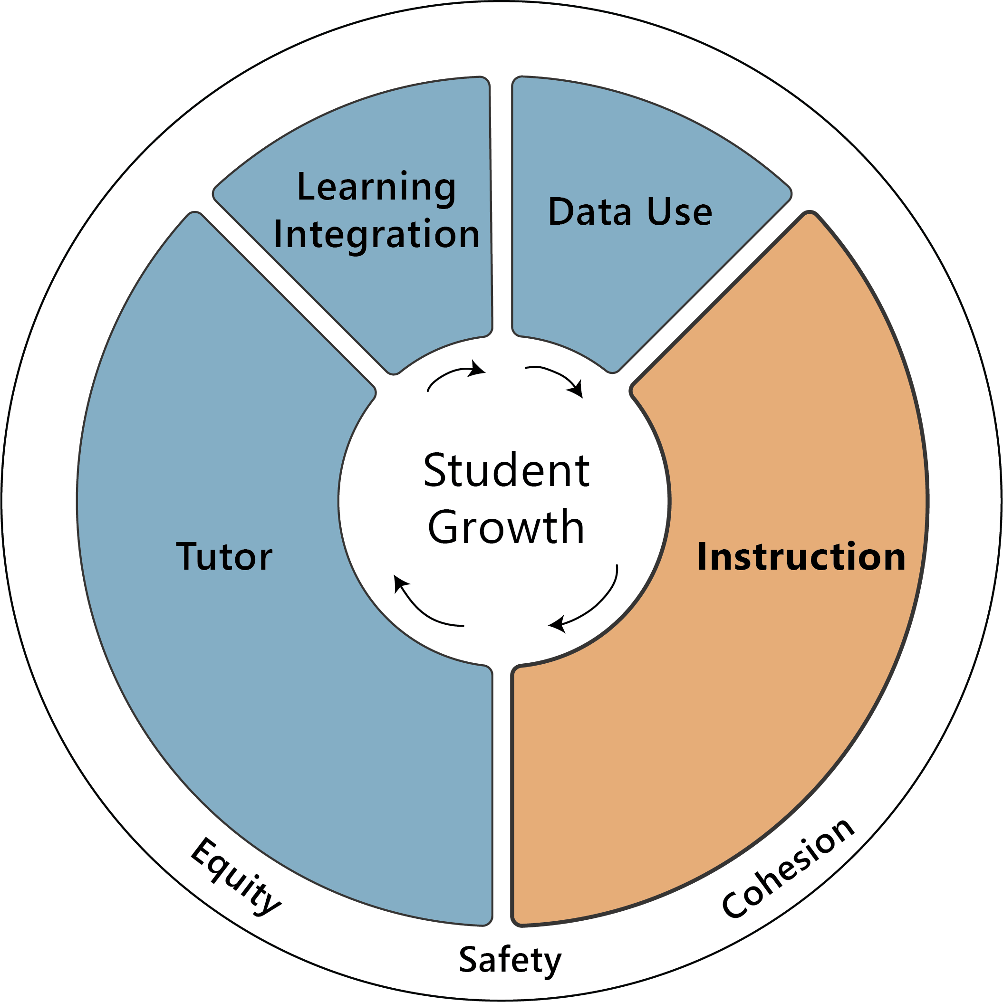
Instruction
Tutoring sessions include a
minimum of three sessions per week in small groups.
For tutoring approaches to be effective, students have to spend substantial time working with their tutor.
Optimal duration of sessions depend on the program’s content area and student age.
Group size is small (up to 3:1 ratio) to allow for personalized instruction.
Materials are high quality and aligned with state standards.

Slide 19
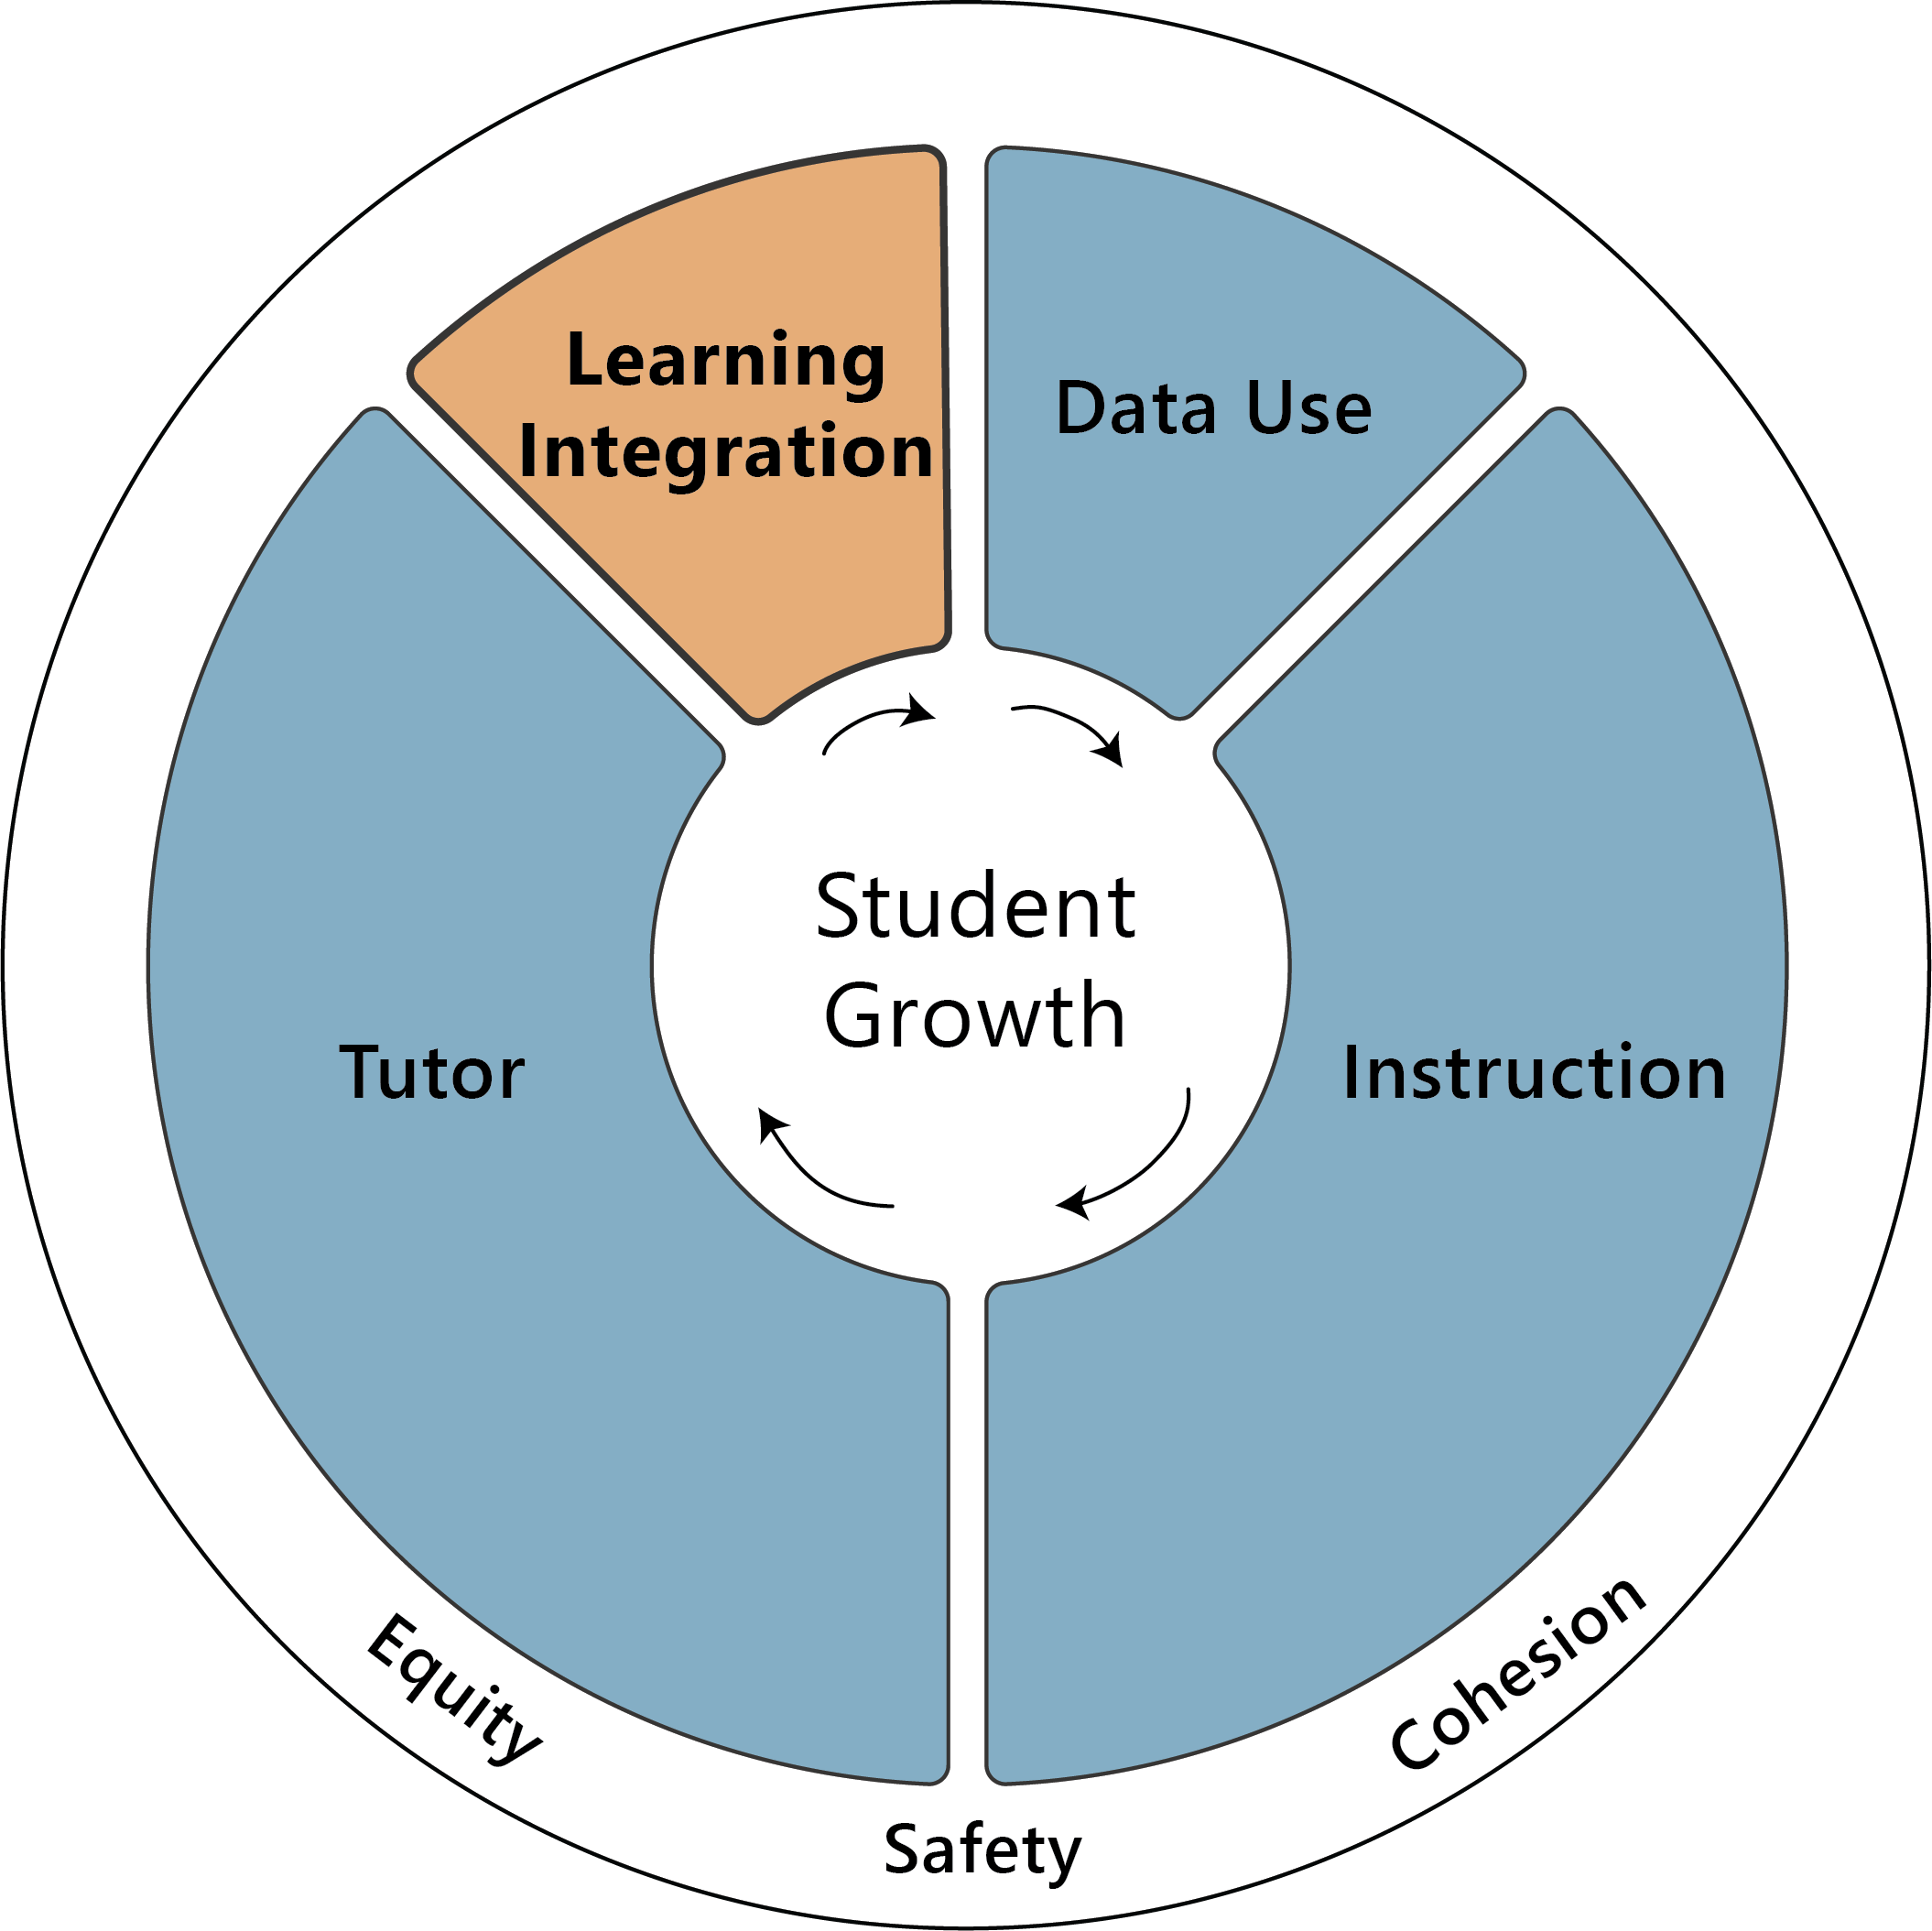
Learning Integration
High-impact tutoring is embedded in schools either during the school day or immediately before or after the school day.
Embedding tutoring into the school program has many benefits including:
Creating a significantly higher likelihood of student attendance
Reaching the students who need it most
Not conflicting with extra-curricular activities such as clubs, sports or work

Slide 20
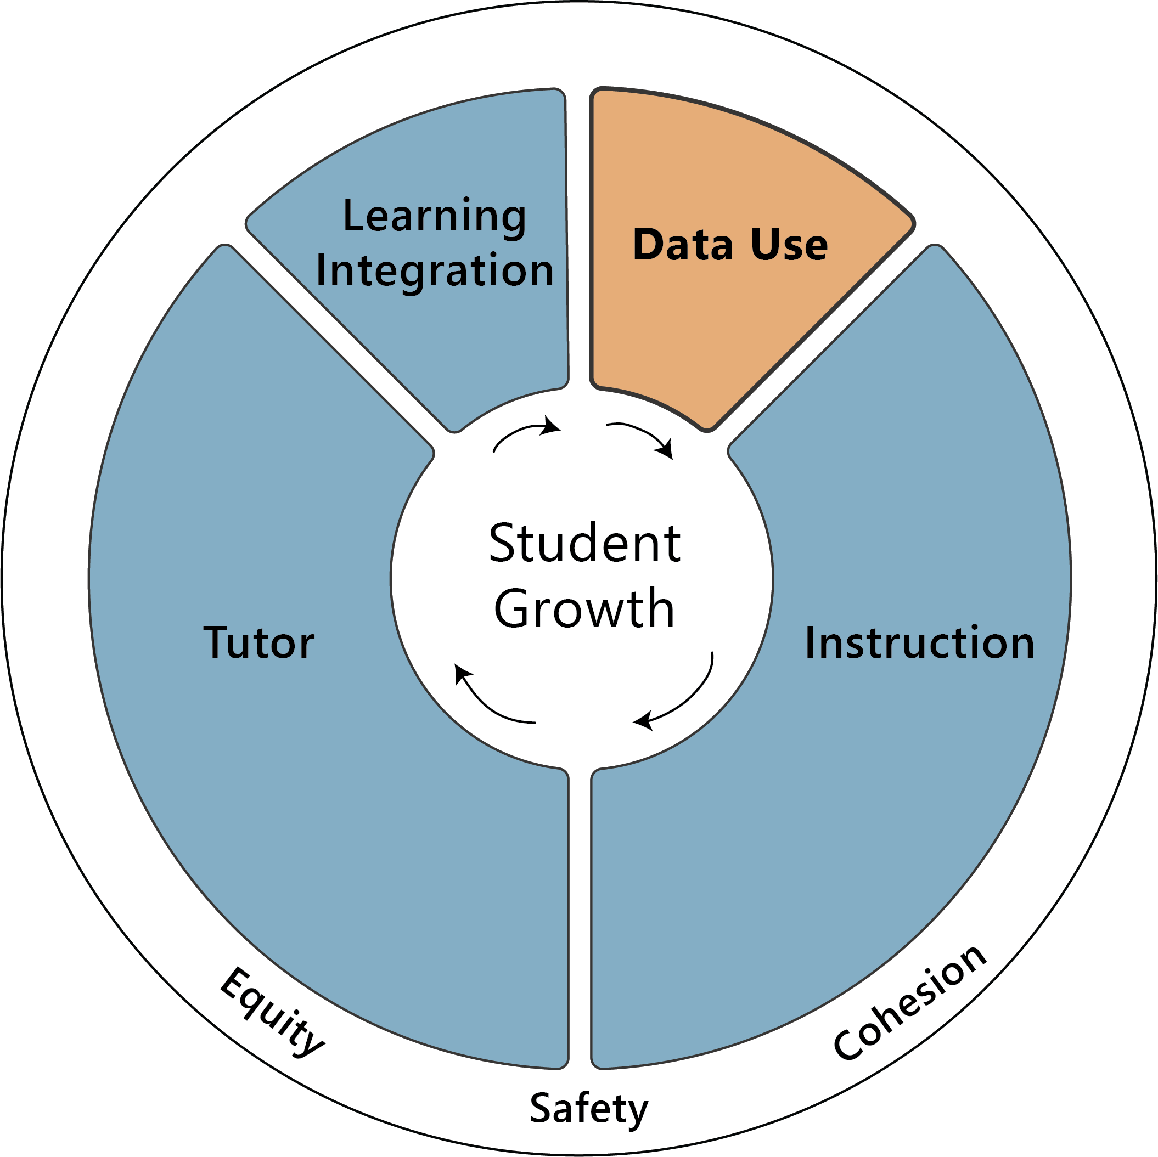
Data Use
Data informs tutoring sessions.
Tutors consistently use data to understand students strengths and needs, and build their sessions to focus on the needs.
Tutoring programs use data to assess their effectiveness at improving student learning and make adjustments based on these data.

